Slide 1
Wisconsin Municipal Treasurers Association September 24, 2015 Public Service Commission Rules and Procedures
Brad Rose, Consumer Analyst
Division of Water, Telecommunications & Consumer Affairs
Public Service Commission of Wisconsin

Slide 2
Today’s Topics
Overview of Commission & Consumer Affairs Unit
Customer Service Practices: What’s required and what’s not?
Utility Customer Service Goals
Collection Tools
Disconnections
Deferred Payment Agreements
Billing Basics
Filed Rates and Rules
When to Start and Stop Base Charge Billing
PSC Dispute Procedures
Rulemaking, Policy and Compliance Updates
2013 Wisconsin Act 274
Records Retention
PSC Web Site

Slide 3
Wisconsin PSC Overview
Three governor-appointed commissioners serve staggered, six-year terms.
Chairperson Ellen Nowak
Commissioner Phil Montgomery
Commissioner Mike Huebsch
Goal: Ensure access to affordable, reliable, safe, and sustainable electricity, natural gas, and water for every Wisconsinite through regulation of the state’s utilities.

Slide 4
PSC Authority
Commission authority is generally found in chapter 196 of the Wisconsin Statutes.
State law grants the Commission broad authority to regulate public utilities:
Wis. Stat. § 196.02(1) Jurisdiction. “The Commission has jurisdiction to supervise and regulate every public utility in this state and to do all things necessary and convenient to its jurisdiction.”
Provides for the regulation of retail rates, construction, stock and bond issuance, accounting practices, mergers and acquisitions, and holding companies.
Provides for addressing consumer complaints, quality of service and education of consumers.

Slide 5
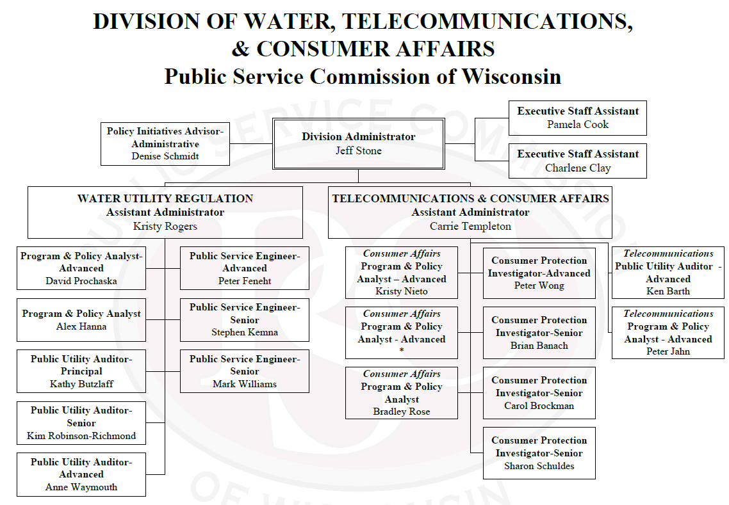
Organizational Chart Division of Water, Telecommunications & Consumer Affairs
Notes:
Bruce Schmidt retired
Mark Williams started on July 13th

Slide 6
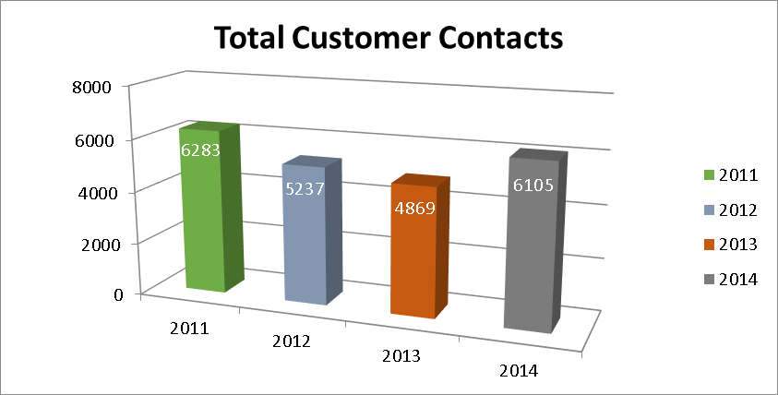
Overview of PSC Consumer Affairs
The PSC received 6,105 contacts in 2014
2,449 of these were complaints, mostly handled by the Consumer Affairs unit
We rely on people like you at the utility to investigate and respond to complaints
Contact us to help resolve disputes prior to the customer filing a complaint
Utility inquiries increased by 71% from 2013 (447) to 2014 (763).

Slide 7
Customer Service Practices What’s required and what’s not?

Slide 8
Utility Customer Service Goals
A utility’s customer service goals are to:
Maximize collections
Minimize future losses
Provide fair, nondiscriminatory utility service
These goals are accomplished by:
Having clear policies in place and in writing
Communicating with customers
Being consistent and persistent
Maintaining positive customer and community relations
Trying not to take it personally

Slide 9
Municipal Utility Collection Tools
Utilities are required to offer a DPA to a customer who cannot afford to pay the balance in full (unless the utility has a different DPA policy in its tariff).
PSC rules allow but do not require utilities to pursue disconnection as a means to collect delinquent accounts.
Municipal utilities may pursue collection through small claims court.
Utilities may consider limited use of the treble damage option in Wis. Stat. § 196.642.
Many municipal utilities use the TRIP Program through the Department of Revenue:
http://www.revenue.wi.gov/ise/trip/index.html
Municipal public utilities are authorized to collect unpaid bills as a lien on the property served, by placing charges on the tax roll.

Slide 10
General Collection Process
Send a bill - allow 20 days for payment
Contact customer if bill isn’t paid
-reminder letter, phone call or postcard
Negotiate a DPA
Disconnect service if no payment is made
Transfer arrearages to the tax roll in fall

Slide 11
Handling Difficult Disconnections
Best Practices
Have a clear disconnection policy in place and in writing.
Having clear disconnect thresholds by class, based on amount and age of arrears, is helpful.
Be consistent and persistent when following your policy.
Remain calm and don’t take the situation personally.
If needed, contact Commission staff ahead of time to review the situation prior to contacting customer.
After a customer has pursued available remedies with the utility, he or she may contact the Commission.
Staff will determine if the contact is a complaint or an inquiry.

Slide 12
Deferred Payment Agreements (DPAs) Wis. Admin. Code §§ PSC 113.0404 (Electric) PSC 134. 063 (Gas) PSC 185.38 (Water)

Slide 13
Deferred Payment Agreements
Deferred payment agreements (DPAs) must be offered to all residential customers (some municipal utilities have filed DPA rules specific to tenants).
May offer DPAs to commercial customers.
Each customer’s circumstances are different; situations should be reviewed on a case-by-case basis.
A DPA consists of the following:
A sizeable down payment on the total amount owed.
Installments on the balance after receipt of the down payment.

Slide 14
Deferred Payment Agreements
Depending on the individual situation, a down payment of 50% of the arrears balance may be a reasonable starting point when negotiating a DPA.
Written DPAs are helpful, but are not required.
Customers on DPAs must pay the current bill on time, in addition to the agreed upon installment payment.
DPAs are not subject to a finance charge or late fee.
Accounts with active DPAs cannot be transferred to the tax roll.

Slide 15
What Happens If You Can’t Agree on a DPA?
The utility can contact the PSC for information and/or guidance on specific situations.
If a DPA cannot be reached because the customer’s offer is unacceptable, the utility must inform the customer in writing why the offer is not acceptable.
If the utility and customer cannot agree on the terms of a DPA, inform the customer of his or her right to contact the Public Service Commission.

Slide 16
Billing Basics

Slide 17
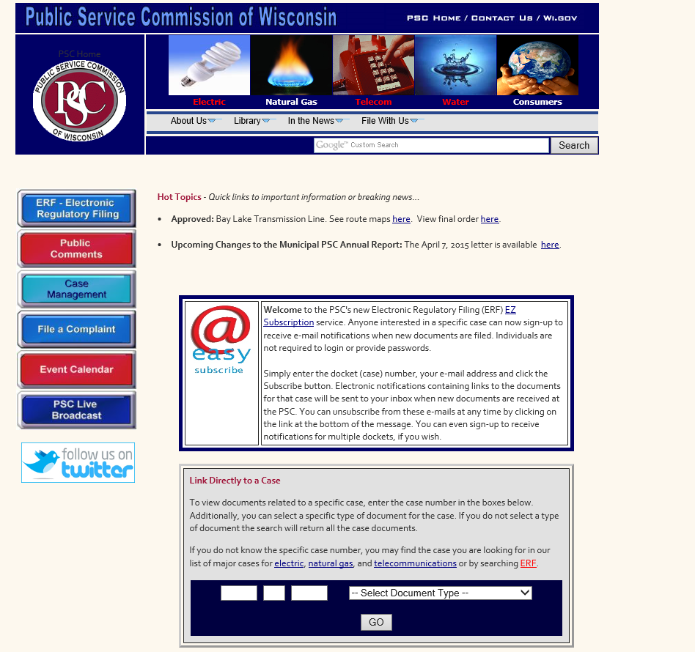
Filed Rates and Rules (Tariffs)
http://psc.wi.gov/

Slide 18
Filed Rates and Rules (Tariff)
Every utility shall furnish reasonably adequate service and facilities at the rates filed with the commission and subject to these rules and the rules of the utility applicable thereto and not otherwise.
Wis. Admin. Code § PSC 113.0201
Wis. Admin. Code § PSC 134.03
Wis. Admin. Code § PSC 185.13
A utility must provide service subject to its tariff.
Utilities must request a tariff change with the Commission prior to implementing any change to a filed rate or rule.
A utility also must provide service subject to its own policies.
Policies must conform to statutes, PSC regulations and tariff.
Discrimination prohibited.

Slide 19
Filed Rules
Electric
Schedule X-1 (General Service Rules)
Schedule X-2 (Supplemental Customer Rules)
Gas
Schedule Srvc (General and Supplemental Service Rules)
Water
Schedule X-1 (General Service Rules)
Schedule X-4 (Supplemental Customer Rules)
Notes:
Call us with any questions
Avoids refunds and backbills!

Slide 20
When to Start and Stop Base Charge Billing
When a new customer (different name) applies for service and is approved.
When a customer requests to have service “shut off” or to “close the account”
"Customer-requested termination" means that the customer or occupant has asked the utility to cease providing utility service to a premises, to close the account or to take their name off the account.
A termination request can be seasonal/temporary or permanent.

Slide 21
Customer-Requested Termination - Temporary
Temporary Disconnections
are voluntary
involve the same customer requesting to reconnect service (within 12 months):
Temporarily disconnected or "seasonal” customers are responsible for minimum customer charges, whether or not the meter is removed.
Seasonal customers are generally back billed for these charges upon reconnection or, if requested by the customer, billing may continue on the utility’s regular billing schedule.
In addition, the reconnection charge would apply to this customer upon reconnection.

Slide 22
Customer-Requested Termination - Permanent
Permanent Disconnections:
The same customer at the same address remains disconnected for 12+ months.
This person is not a customer of the utility during the 12+ month period and is not subject to any charges for service while disconnected.
Possible exceptions for water utilities only
Utilities that have a standby charge for non-customers under Schedule SWS-1
Utilities that have direct charges for public fire protection under Schedule F-1 or Fd-1 that also apply to non-customers.

Slide 23
Not So Permanent Disconnections
If, after requesting permanent disconnection, this same customer were to reconnect service at this same address within 12 months of disconnection:
This was not a permanent disconnection.
The utility should back bill for the customer charges for the period this customer was "temporarily" disconnected.
The reconnection charge would apply to this customer upon reconnection.
If a customer that requests disconnection and reconnects at the same address within 12 months, but there was another customer in between, the charge is not allowed.

Slide 24
Common Questions
Billing after cancellation
Not permitted unless the cancellation would endanger the health of another party and the utility has reasonable grounds to believe the customer continues to occupy the residence.
If the customer cancels service, and the landlord indicates that the lease is not expired:
The utility is not party to a lease.
Service can be disconnected and billing will cease or, if requested by the landlord, service can be placed into the landlord’s name.

Slide 25
When You and the Customer Cannot Agree: PSC Dispute Procedures
Wis. Admin. Code §§
PSC 113.0407 (electric)
PSC 134.064 (gas)
PSC 185.39 (water)

Slide 26
Before the Customer Files a Complaint with the PSC
Commission rules require customers to attempt to resolve the issue with the utility before filing a complaint with the Commission.
When a customer contacts a utility to dispute the utility’s actions, the utility is required to:
Investigate the dispute promptly and completely;
Advise the customer of the results of the investigation;
Attempt to resolve the dispute; and
Provide the opportunity for the residential customer to enter into a deferred payment agreement (DPA), when applicable, in order to resolve the dispute.

Slide 27
If the Dispute Persists
After a customer has pursued available remedies with the utility, he or she may contact the Commission to file a complaint.
The role of Commission staff is to ensure utilities are complying with the rules and regulations in the Wisconsin Administrative Code and Wisconsin Statutes related to the provision of utility service.

Slide 28
PSC Complaints: Designated Utility Employees
Utilities are required to designate employees for responding to Commission complaints.
Designated employees must:
Be readily available to respond to the complaint; and
Have a sufficient authority level for investigating and taking action to address the concerns.
Utilities are required to provide the names of the designated employees to the Commission (and promptly inform the Commission of any changes in these designations).

Slide 29
Handling PSC Complaints
When a utility receives a complaint from the Commission, the utility is required to:
Contact the customer who filed the complaint within 2 business days (or 4 hours in an emergency situation)
Provide a response to the Commission within 10 business days
Hold the disconnection of the customer’s service, if applicable, during the time the complaint is investigated, and for at least 7 calendar days after the date the Commission staff closes the complaint

Slide 30
Handling PSC Inquiries
When a utility receives an “Inquiry” from the Commission, the utility is not required to contact the customer or provide a response to the Commission.
However, the utility is expected to:
Review the information provided by the customer and Commission staff;
Make contact with the customer, if the utility feels it would be helpful in resolving the dispute based on the information provided; and
Notate the customer’s file regarding any action taken.

Slide 31
2013 Wisconsin Act 274
DPAs, Tax Roll,
Landlords and Tenants

Slide 32
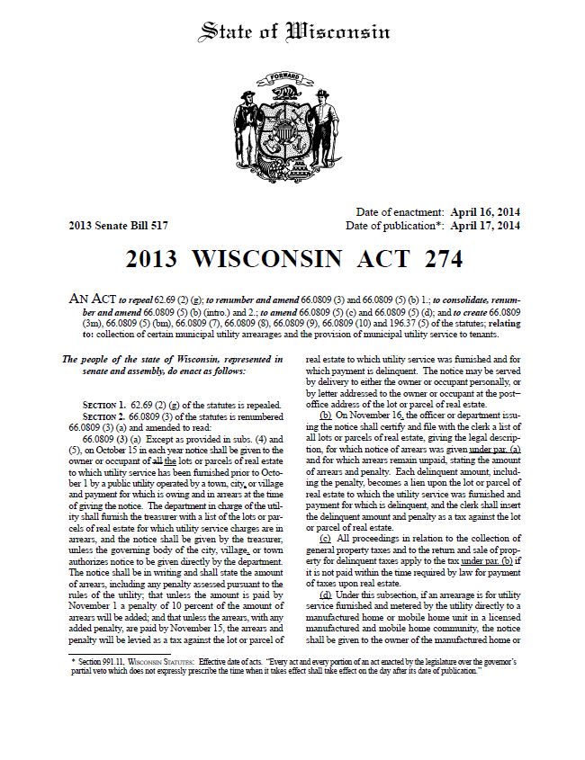
2013 Wisconsin Act 274
2013 Wisconsin Act 274 – Enacted April 16, 2014
Made various changes to statutory tax roll provisions.
Permits utilities to adopt rules and practices that distinguish between customers who own or rent property.
A municipal utility must provide service subject to its filed rates and rules.
Utilities must request a tariff change with the Commission prior to implementing any change to a filed rule.

Slide 33
2013 Wisconsin Act 274
Major provisions:
Municipal utility not required to offer DPA to tenants
Municipal utility may adopt different application, deposit, disconnection or application rules for customers who are tenants
Changes to the tax roll process
Disconnection of electric (not water) at the request of property owner, in some situations
Disclose to the property owner whether a new or prospective tenant has past-due charges

Slide 34
Act 274 – DPA Tariff Changes
Considerations prior to making a DPA tariff change request:
Composition of customer base.
Prohibits utilities from providing DPAs in these situations.
Impact on community.
Process to request a DPA tariff change:
ERF request to Commission.
Public Notice and Hearings are required.
Tariff in effect once receive signed letter and new tariff sheets from DWTCA Administrator.

Slide 35
Pre-Approved DPA Tariff Criteria
The Commission has pre-approved four criteria that a utility may include in a revised DPA tariff.
These pre-approved criteria do not need to go to the full Commission for approval and provide language under which a municipal utility cannot offer DPAs to residential tenants:
$100 more than 90 days past due
DPA default in past 12 months
Had past due balance transfer to tax roll in past 24 months
Winter moratorium balance that is 80+ days past due
Below is a link to the Commission’s final decision and the pre-approved criteria.
http://psc.wi.gov/apps35/ERF_view/viewdoc.aspx?docid=215095

Slide 36
Tax Roll/Lien Process Act 274 — Step 1
Notice to landlord
Utility must provide a 14-day notice to use the tax roll process (Wis. Stat. § 66.0809(b))
No 14-day notice, no tax roll process
14-day notice : utility serves the notice on the owner or the rental dwelling unit (landlord) within 14 days of the date when the tenant’s charge became past due.
Notice must be written and hand delivered, mailed or faxed (Wis. Stats. § 801.14(2))

Slide 37
Tax Roll/Lien Process Act 274 — Step 2
October 15 – Utility or treasurer provides notice to owner (landlord) AND tenant
Amount of arrears and penalty
Must be paid by November 1, or a 10% penalty will be added
If not paid by November 15, the arrears will be placed on the parcel’s property tax bill
October 15 – Utility or treasurer provides notice to tenant
Lien has arisen on the tenant’s assets for unpaid arrears
Lien will transfer to landlord if s/he pays the arrears

Slide 38
Tax Roll/Lien Process Act 274 — Step 3
Payments made between October 15 and November 15
Tenant payment before November 15
Lien is satisfied; nothing to the tax roll
Landlord payment before November 15
Municipality transfers lien to landlord; landlord decides to file a Notice of Lien with the Clerk of Courts
Nothing to the tax roll
No payment before November 15
Municipal lien on tenant’s assets intact
Arrears go to the tax roll

Slide 39
Records Retention
Customer Records:
What’s Required?

Slide 40
Records Retention
The following records shall be preserved and kept available for inspection by the Commission for the period indicated.
Meter Retention Rules went into effect August 1, 2015 (1-AC-227).
Please follow water rulemaking docket 1-AC-233 for future changes.
Description of Record | Period to be Retained
Complaint Records | 3 years after the complaint is resolved
Customer Deposit | 6 years after refund
Meter Reading Records used for Billing | 6 years
Billing Records | 6 years
Filed Rates and Rules | Permanently

Slide 41
PSC Web Site
http://psc.wi.gov
ERF (Electronic Regulatory Filing)
Tariffs
Administrative Codes and Statutes
Filing Requirements for Projects
Rate Setting
Accounting
Utility Education and Fact Sheets
Annual Reports
Key PSC Contacts

Slide 42
Questions ??

Slide 43
Contact Information
Public Service Commission of Wisconsin
Division of Water, Telecommunications & Consumer Affairs
Consumer Analysts
Brad Rose, Bradley.Rose@wisconsin.gov, (608) 267-9491
Kristy Nieto, Kristy.Nieto@Wisconsin.gov, (608) 261-9419
~
Carrie Templeton, Assistant Division Administrator
Phone: (608) 266-1267
CarrieE.Templeton@wisconsin.gov
~
Please do not provide the above contact information to customers!
PSC Phone Numbers and Email Address to Provide to Customers
Telephone: 1-800-225-7729 (toll-free) or 608-266-2001
Email: PSCConsumerAffairsMail@wisconsin.gov
File a Complaint Online: www.psc.wi.gov

