Slide 1
DOR Collections & Unclaimed Property

Slide 2
DOR Collection Options
Balance your debt collection program:
Tax Refund Interception Program (TRIP) –refunds and other payments pay certified debts
Statewide Debt Collection (SDC) – full collection services

Slide 3
SDC – Statewide Debt Collection
The difference between SDC and TRIP is that DOR becomes collector of the SDC debt
Agency must stop all collections

Slide 4
SDC – Statewide Debt Collection
DOR collection services include:
Payment plan
Wage attachment
Levy of assets
Refund offset

Slide 5
SDC Payments
36% Voluntary
32% Wage Attachment
19% Refund Offset
11% Levy
Other: Unclaimed property, vendor setoff

Slide 6
Collections Success
238 agencies – state, court and local government
Debt Roll: $79 Million
Collections:
FY 2012: $4.1million,
FY 2013: $9.7 million,
FY 2014: $12.0 million,
FY 2015: $15.0 million,
FY 2016: $20.7 million

Slide 7
To Enroll in SDC
Go to: https://www.revenue.wi.gov/html/debtcoll.html
Submit:
SDC agreement
DOA-6456 STAR Authorization for Electronic Deposit
Review SDC User Guide and My Tax Account (MTA) – SDC User Guide

Slide 8
SDC Contact Information
Call 608-264-0344
Email: trip@revenue.wi.gov
Staff:
Joseph Mugenga: joseph.Mugenga@revenue.wi.gov
Roxanne Walker: Roxanne.walker@revenue.wi.gov

Slide 9
DOR Setoff Hierachy
Refunds are setoff in the following order per s. 71.93, Wis. Stats
Wisconsin Department of Revenue (DOR) administered debts
Child support debts referred by DCF
Restitution debts, first to SDC debts, then TRIP debts
SDC debts, first to State Agencies, then to local governments
TRIP debts, first to State Agencies, then to local governments
Federal government debts
TRIP debts referred by Tribal governments
Other states’ debts

Slide 10
What is Unclaimed Property?
Any financial asset that hasn't had owner activity for a specific time AND the holder of the asset is not able to contact the owner
Examples include: bank accounts, uncashed payroll checks, stocks/mutual funds, credit balances, uncashed dividends
Most property is intangible; however, we do get some stocks, mutual funds, and safe deposit boxes

Slide 11
Who Reports Unclaimed Property?
Holders of unclaimed property are defined as any business, individual, or other entity in possession or control of property belonging to another
Holders must make final attempt to locate owner before reporting property to DOR

Slide 12
Who Reports Unclaimed Property?
Reports & payments are due November 1st each year for prior fiscal year (July 1 – June 30)
Interest is assessed on all late filed or late paid holder reports
Review Holder Report Guide on our website for more information

Slide 13
DOR Administration
DOR is the custodian of the property on behalf of the owner
Property is held in perpetuity, until owner (or their heirs) come forward
$487 million in Unclaimed Property currently held

Slide 14
DOR Administration
Program moved from the Office of State Treasurer in July 2013
2013 WI Act 308 – effective 7/1/2015
Unclaimed Property converted into our integrated tax processing system in March 2015

Slide 15
How Do We Locate Owners?
Annual newspaper advertisements – new properties over $50
Online listing of all properties over $5
Automated claims – data matching process began 7/1/2015
Checks sent for properties up to $2000
Auto claim letters sent for properties $2000 or more

Slide 16
Unclaimed Property Data Matching
Properties are matched against individual current year individual income tax returns
$16.6 million returned for 121,497 properties
521 auto claims worth $4.75 million still waiting to be claimed
Data matching process is ongoing

Slide 17
UCP & Local Government
Make sure you're enrolled in TRIP & SDC, as Unclaimed Property refunds are treated just like tax refunds for setoff!
If you have a judgment for a debtor, you can also file a creditor claim for their property

Slide 18
UCP & Local Government
Check our system to make sure your municipality does not have unclaimed property
Search on iterations of your municipality name AND city departments
Sun Prairie City
Madison Treasurer
Wausau Public Works
If you find property, file a claim using "Government" relationship type

Slide 19
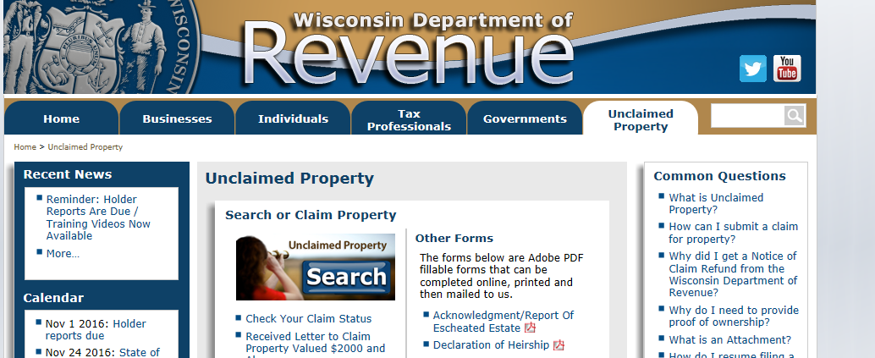
UCP System Demonstration
www.revenue.wi.gov – Click on Unclaimed Property tab

Slide 20
UCP System Demonstration
How to search for property
How to file a claim
Documentation required
Confirmation page
Save and Finish Later

Slide 21
UCP Contact Information
608-264-4594
DORUnclaimedProperty@Wisconsin.gov

